Slide 1
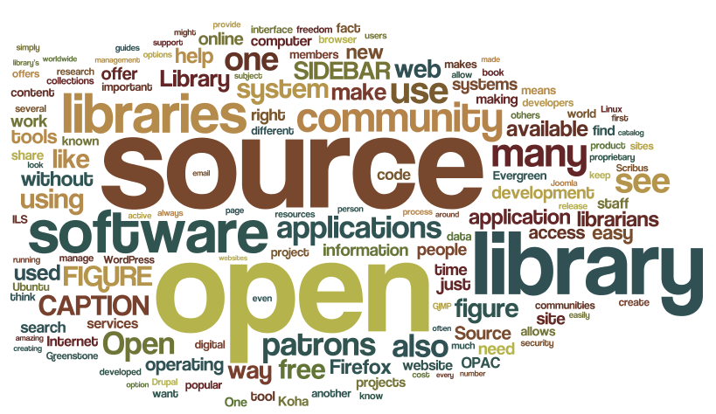

Slide 2
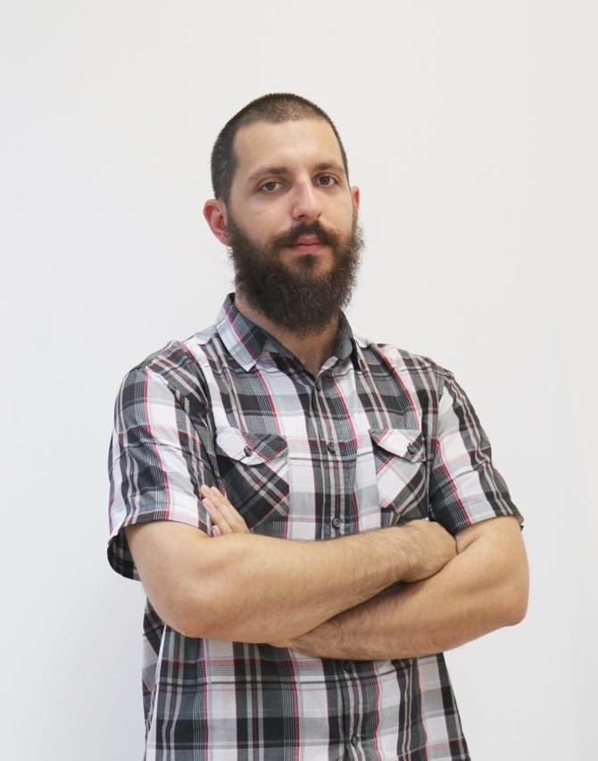


About me
Name: Hristiyan Hristov
<3: JS, Coffee,
<3: Brazilian Jiu-Jitsu, Shishaa
<3: …
Job: HILLGRAND
github.com/Xapuu
xapu.Ivanov@gmail.com
Notes:
# Introduction
Today we are here to have a brief discussion to the topic "Open Source"
* For those that don't know what's the meaning of the term to find out about it
* For those that know what open source is, but have some doubts about its foundation and principles, to prove them with some examples that if OS is done right it works
* And for the rest, that are OS knowledgeable , I hope that you will have good time listening to this talk and after that I would love to have some chats, about your passions in the OS world

Slide 3
Open Source 101
Notes:
# Introduction
Today we are here to have a brief discussion to the topic "Open Source"
* For those that don't know what's the meaning of the term to find out about it
* For those that know what open source is, but have some doubts about its foundation and principles, to prove them with some examples that if OS is done right it works
* And for the rest, that are OS knowledgeable , I hope that you will have good time listening to this talk and after that I would love to have some chats, about your passions in the OS world

Slide 4
Game Plan
History lesson
Open vs Proprietary software
Business models
Open Source IRL for developers
The principles

Slide 5
"The term "open source" refers to something people can modify and share because its design is publicly accessible."
-- as seen on " openSource.com "

Slide 6



50's – 70's
Notes:
# 50's – 70's
* Academics and corporate researchers working in collaboration, under the principles of openness and co-operation
* Most of the software is in the public-domain
In the beginning almost all software was produced by academics and corporate researchers working in collaboration, often shared as public-domain software, along with its source, it was generally distributed under the principles of openness and co-operation long established in the fields of academia and was not seen as a commodity.
Part of the reason behind this behavior was that often a piece of software would need modification to run on different OS and hardware, latter on this behavior led to the establishment of the so called 'hacking culture'.
The first example of open-source software (according to Wikipedia) is believed the "A-2 system" , which was released to customers with its source code. Additionally the users were invited to send their improvements back to UNIVAC (the creators)

Slide 7


The rise of proprietary software
Notes:
AT&T develop 'Unix' in their "Bell labs" and license it
Ken Thompson (UTF8, co-inventor of 'GO' ) and Dennis Ritchie (created 'C')
1971 first release
AT&T 80-s start selling "Unix " under the name "System V"
In 1979, AT&T began to enforce its licenses when the company decided it might profit by selling the Unix system.
In 1976 Bill Gates wrote an essay entitled Open Letter to Hobbyists
he expressed dismay at the widespread sharing of Microsoft's product Altair BASIC by hobbyists without paying its licensing fee.
To increase revenues, a general trend began to no longer distribute source code (easily readable by programmers), and only distribute the executable machine code that was compiled from the source code. One person especially distressed by this new practice was Richard Stallman. He was concerned that he could no longer study or further modify programs initially written by others
Berkley Unix
BSD
Berkley

Slide 8
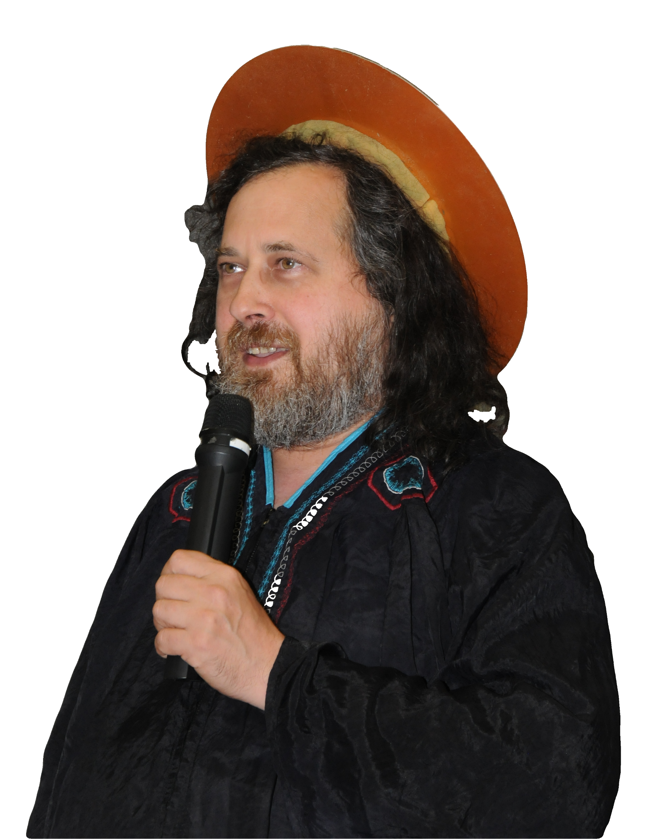

Richard Stallman
Notes:
The GNU Project is a free-software, mass-collaboration project, first announced on September 27, 1983 by Richard Stallman at MIT
By 1991 almost all software needed for OS was ready besides the low-level kernel (GNU Hurd, was not complete)
# The four freedoms
freedom to run a program for any purpose
freedom to study the mechanics of the program and modify it
freedom to redistribute copies
freedom to improve and change modified versions for public use
# GPL : General Public License
Copy left
# LGPL : Lesser General Public License
Free software that can be part of proprietary software

Slide 9
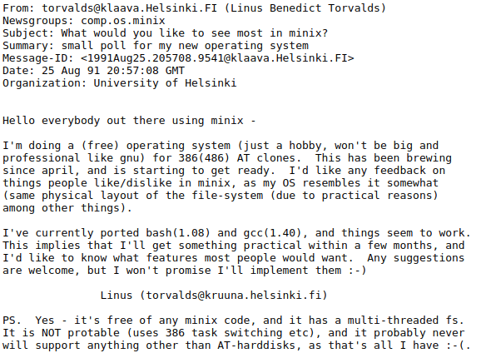
The rise of open source
Notes:
# Key points
* We have young hacker, that is creating a free operating system that runs on easily accessible hardware, inspired by GNU

Slide 10
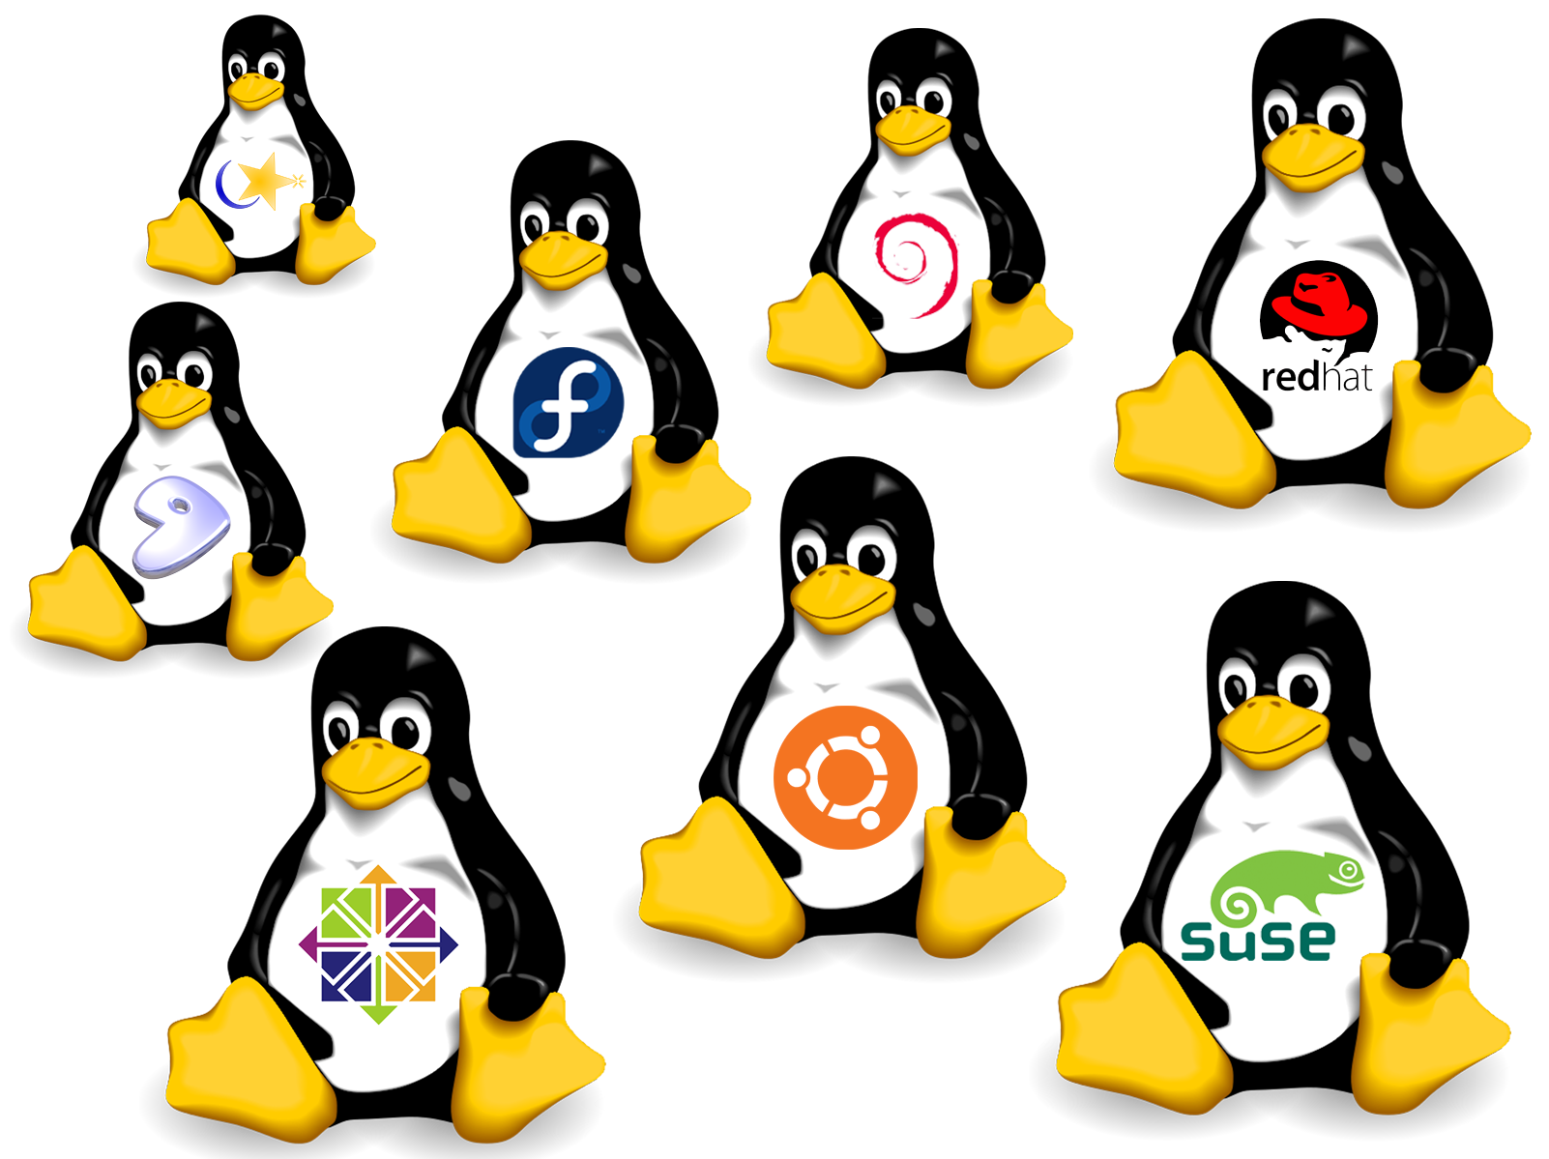
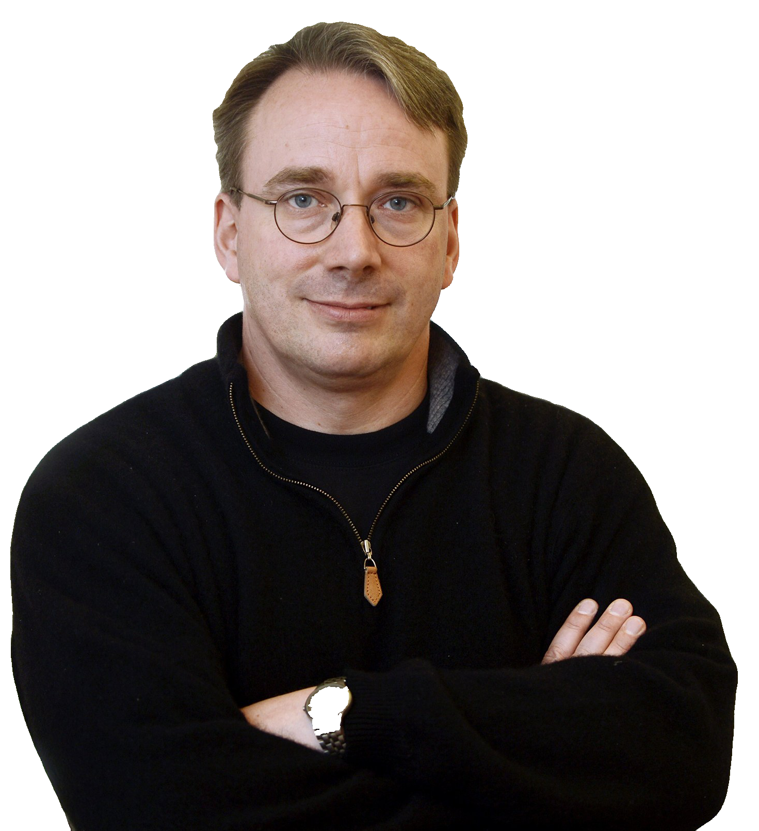


Linus Torvalds
Notes:
* First Linux Kernel, version 0.01, had just 10,239 lines of code
Debian 0.01, released on September 15, 1993
First public release 1994, Bruce Perens takes over Debian core
1996 Bruce Perens Takes the leadership of the project
* Today, over 80% of Linux contributions come from developers paid by big enterprises. Intel tops the list of contributors. Microsoft too is also among the biggest contributors to Linux kernel.

Slide 11

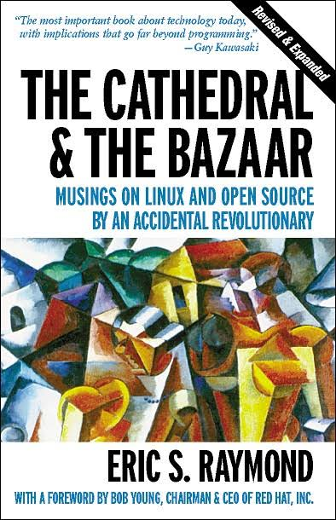

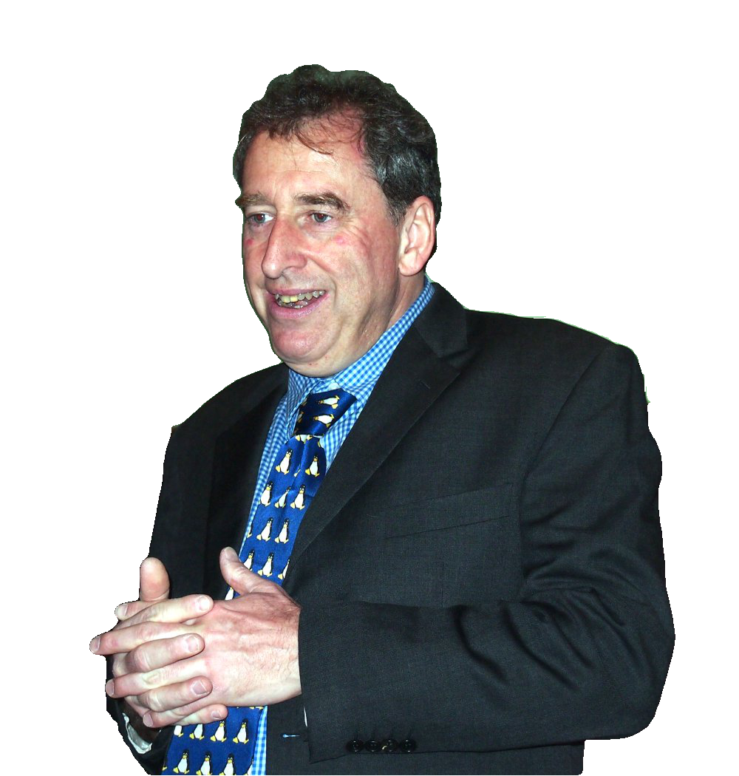
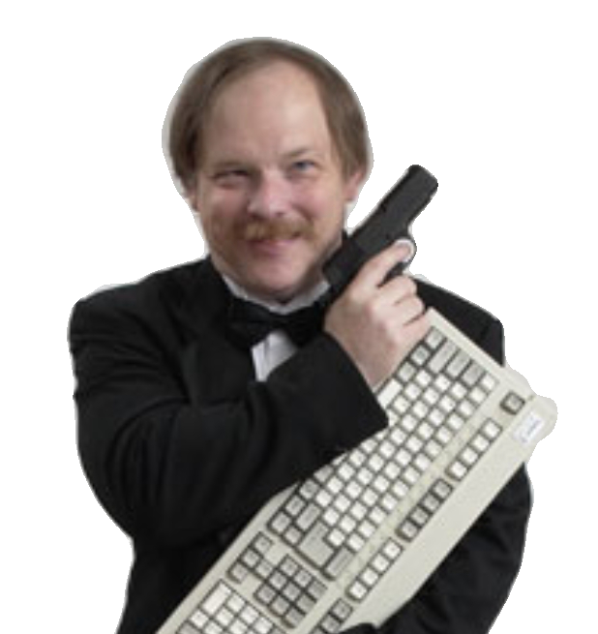

Eric S. Raymond
Bruce Perens
Notes:
Eric S. Raymod
Raymond coined an aphorism he dubbed "Linus's Law", inspired by Linus Torvalds: "Given enough eyeballs, all bugs are shallow". It first appeared in his book The Cathedral and the Bazaar.
Bruce Perens
* 1996 takes lead of Debian project and creates their social contract
* 1998 co-founded the Open Source Initiative (OSI) with Eric S. Raymond
* Created "The Open Source Definition" and published the first formal announcement and manifesto of open source

Slide 12
The Open Source Definition
1. Free Redistribution
2. Source Code
3. Derived Works
4. Integrity of The Author's Source Code
5. No Discrimination Against Persons or Groups
6. No Discrimination Against Fields of Endeavor
7. Distribution of License
8. License Must Not Be Specific to a Product
9. License Must Not Restrict Other Software
10. License Must Be Technology-Neutral

Slide 13
The open source principles
Collaboration
Release early and often
Meritocracy
Transparency
Community

Slide 14
Open vs Close source
Pricing
Security
Quality of support
Usability

Slide 15
Open source business models
Support
Open core
Hosting
Advertisement partners
Donations/ Pay what you want

Slide 16


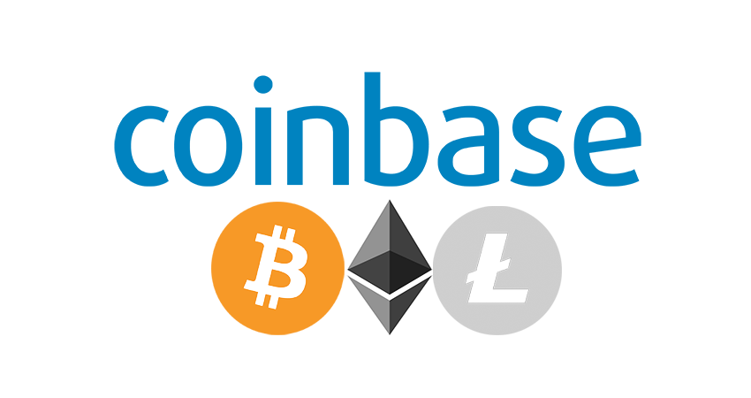
Success Stories
Notes:
Mozilla : 550 m$
GitHub : 400 m$
RedHat : 3,500 m$
coinbase: 1500 m$

Slide 17
Open source IRL
Basics
Demo
Why

Slide 18
Basics: What is contribution
Question
Bug
Blog
Business
Code
Content
Doc
Design
Examples
Event organizing
Financial
Funding
Ideas
Infra
Maintenance
Platform
Plugin
Project management
Review
Security
Tool
Translation
Test
Tutorial
Talk
User testing
Video
… and more!
Notes:
# This slide is as seen on: "A new way to contribute to open source" – GitHub Satellite 2019
- Help out with the docs - Review others PR-s
- Help with the administration
- Help with the design
- Help the community
- Just code

Slide 19
Basics: Players
Author
Owner
Maintainers
Contributors
Community

Slide 20
How to be an awesome contributor
Demo
Notes:
s

Slide 21
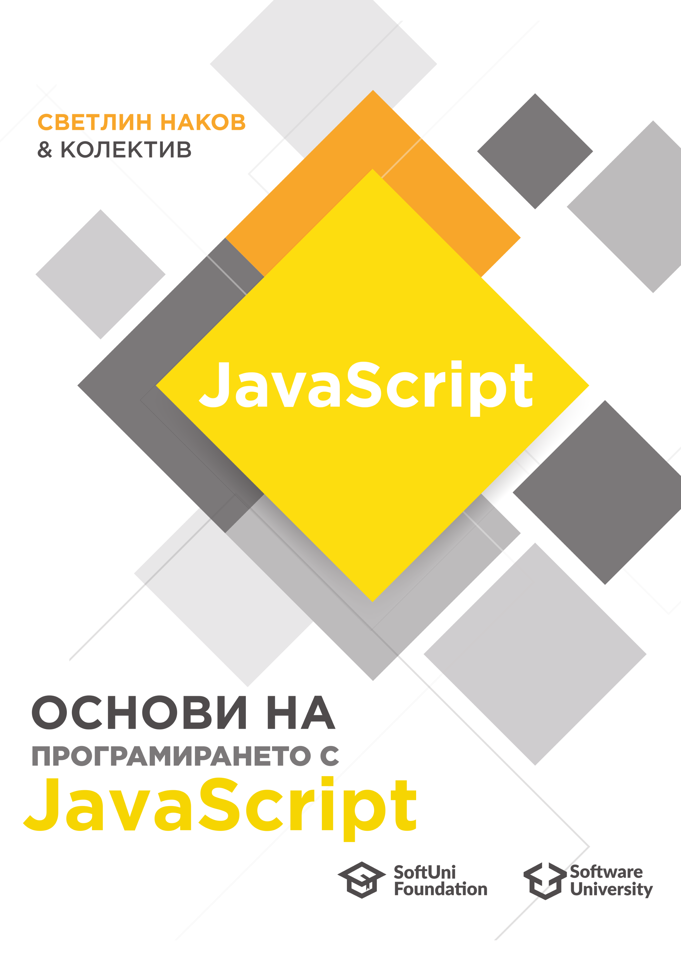
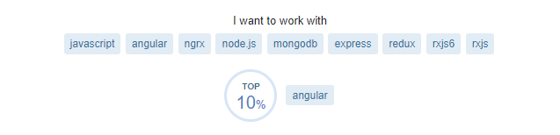
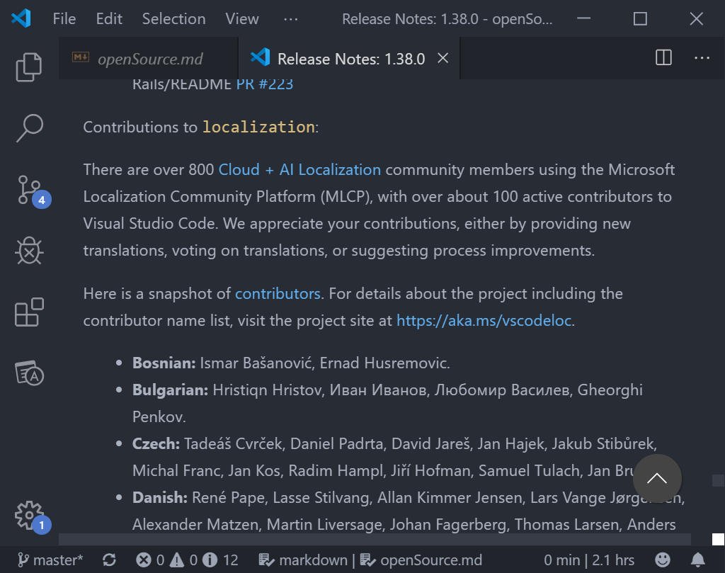
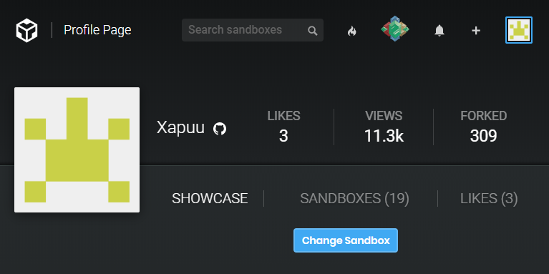
Why to be an awesome contributor

Slide 22

Q ? A : 'Thank you';
Notes:
# Answer questions if any :D
https://github.com/Xapuu/programmingStuff

